Slide 1
Electronic System Components

Slide 2
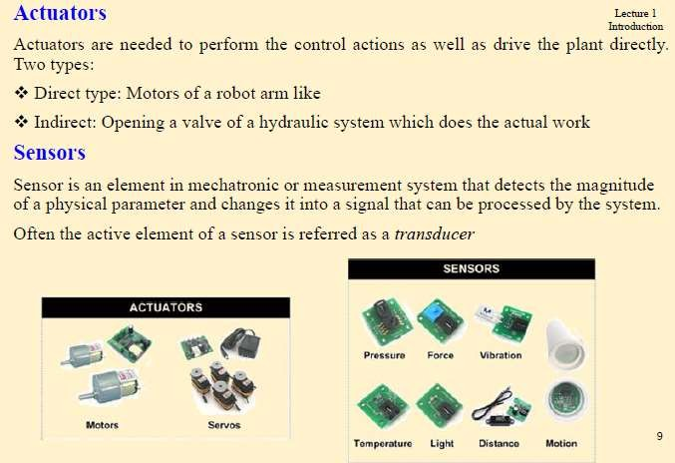

Slide 3
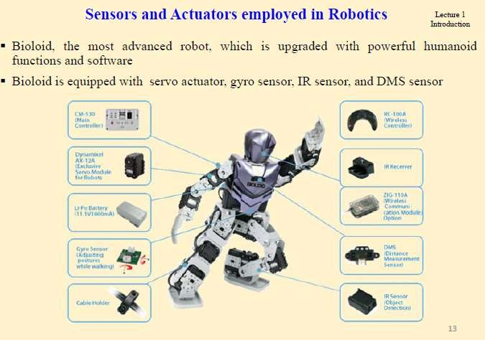

Slide 4
Signal Modification and Conditioning
Signal modification includes signal conversion and signal conditioning and processing.
It plays a crucial role in component interconnection or interfacing. The reasons for this include the following:
When two components are interconnected, their signals are altered (due to dynamic coupling/interaction).
For matching of the interconnected components, their operating signals may have to be modified(with regard to power, type, etc.).
For the purpose of the application, the signal type and characteristics may have to be modified(e.g., power, analog–digital conversion, modulation).
In view of noise and other errors, and system requirements, the signals
have to be conditioned(e.g., filtering, amplification
25

Slide 5
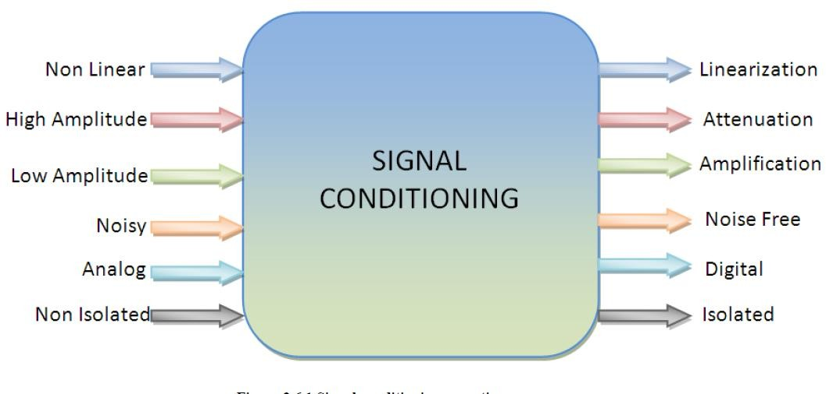
Why Signal Conditioning
26

Slide 6
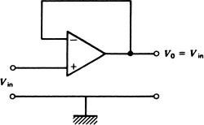
Signal-Modification Hardware
Voltage Follower : Figure shows an op amp circuit with unity gain and very high input impedance. The input impedance is essentially the input impedance of the op amp itself, which can be greater than 100 MOhm .
The op amp voltage follower.
This but
circuit has unity gain very high input
impedance.

Slide 7

Signal-Modification Hardware
The unity gain voltage follower impedance transformer in the sense
is essentially an
a
of converting
voltage at high impedance to the same voltage at low impedance.
Inverting Amplifier: Equation shows that this circuit inverts the input signal and may have either attenuation or gain, depending on the ratio of input resistance,R1 , and feedback resistance,R2 .

Slide 8
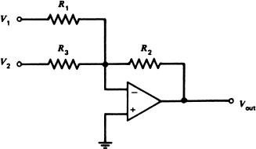

Signal-Modification Hardware
Summing Amplifier A common modification of the
inverting amplifier is an amplifier that sums or adds two or
more applied voltages.
This circuit is shown in Figure for the case of summing two i voltages. The transfer function of this amplifier is given by

Slide 9

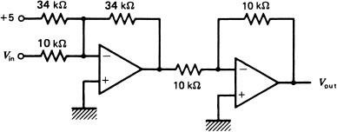
Signal-Modification Hardware
Example : Develop an op amp circuit that can provide an output voltage related to the input voltage by

Slide 10
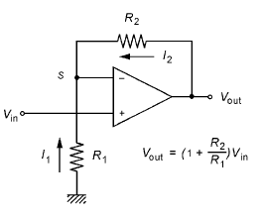
Signal-Modification Hardware
Non inverting Amplifier :A non inverting amplifier may be constructed from an op amp, as shown in Figure . The gain of this circuit is found by summing the currents at the summing point, S, and using the fact that the summing point voltage is Vin so that no voltage difference appears across the input terminals.

Slide 11
Signal-Modification Hardware
Differential
differential amplifier
Instrumentation
Amplifier: An
voltage
ideal with
provides an output
respect to ground that is some gain times the difference between two input voltages
where A is the differential gain and both Va and Vb are voltages with respect to ground. Such an amplifier plays an important role in instrumentation and measurement.

Slide 12
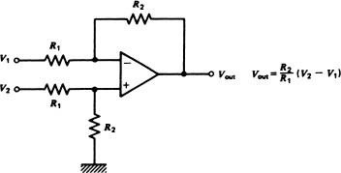
Signal-Modification Hardware
Differential Amplifier There are a number of op amp circuits for differential amplifiers. The most common circuit for this amplifier is shown in Figure

Slide 13
Signal-Modification Hardware
Instrumentation Amplifier Differential
amplifiers
with
high input impedance and low output impedance are given the special name of instrumentation amplifier. They find a host of applications in process-measurement systems, principally as the initial stage of amplification for bridge circuits.
Example: A sensor outputs a range of 20.0 to 250 mV as a variable varies over its range. Develop signal conditioning so that this becomes 0 to 5 V. The circuit must have very high input impedance.

Slide 14

OPAMP CIRCUITS IN INSTRUMENTATION
Voltage-to-Current Converter: Because signals in process control are most often transmitted as a current, specifically 4 to 20 mA, it is often necessary to employ a linear voltage-to-current converter. Such a circuit must be capable of sinking a current into a number of different loads without changing the voltage-to-current transfer characteristics.

Slide 15
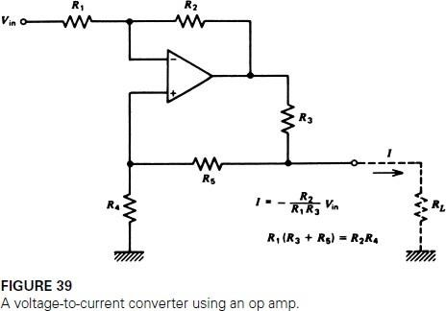
OPAMP CIRCUITS IN INSTRUMENTATION

Slide 16
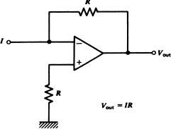
OPAMP CIRCUITS IN INSTRUMENTATION
Current-to-Voltage Converter: At the receiving end of the process-control signal transmission system, we often need to convert the current back into a voltage. This can be done most easily with the circuit shown in Figure . This circuit provides an output voltage given by

Slide 17
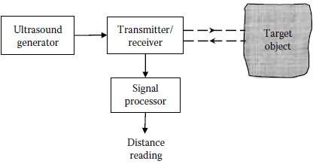
Ultrasonic Sensors
Ultrasound waves are pressure waves, just like sound waves, but their frequencies are higher (ultra) than the audible frequencies.
Ultrasonic sensors are used in many applications, including medical imaging, ranging systems for cameras with autofocusing capability, level sensing, and speed sensing. In medical applications, ultrasound probes of frequencies 40 kHz, 75 kHz, 7.5 MHz, and 10 MHz are commonly used.
In distance (range, proximity, displacement) measurement using ultrasound, a burst of ultrasound is projected at the target object, and the time taken for the echo to be received is clocked. A signal processor
computes the position of the target object, possibly compensating for environmental conditions.
The applicable relation is

Slide 18

where
t is the time of flight of the ultrasound pulse (from generator to receiver) x is the distance between the ultrasound generator/receiver and the target object
c is the speed of sound in the medium (typically, air

Slide 19
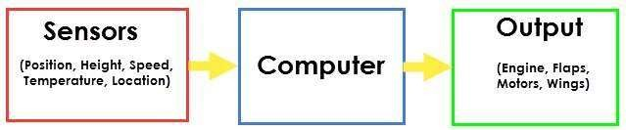
Sensors
Sensor is an element which produces a signal relating to the quantity being
measured.
An input device which provides an output (signal) with respect to a specific physical quantity.
A device that converts signals from one energy domain to electrical domain.

Slide 20
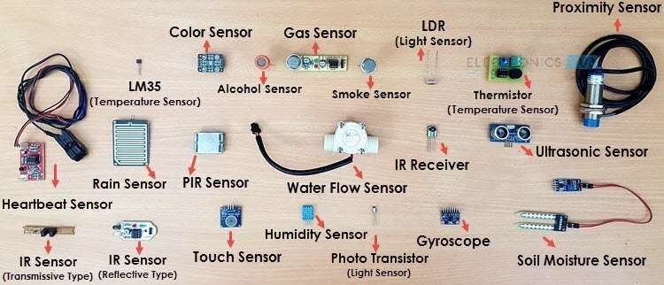
Sensors

Slide 21
Classification of Sensors
The sensors are classified into the following criteria:
Primary Input quantity (Measurand)
Transduction principles (Using physical and chemical effects)
Material and Technology
Property
Application

Slide 22
Classification of Sensors
Active
Sensor: Active Sensors are those which require an external excitation
signal or a power signal. E.g.: LiDAR (Light detection and ranging), photoconductive cell.
Passive Sensor: Do not require any external power signal and directly
generates output response. E.g.:
Radiometers, film
photography
Based on the means of detection
Some of the means of detection are Electric, Biological, Chemical, Radioactive
etc.

Slide 23
Classification of Sensors
Sensors that are commonly used in various applications.
All these sensors are used for measuring one of the physical properties like Temperature, Resistance, Capacitance, Conduction, Heat Transfer etc.
Temperature Sensor
Proximity Sensor
Accelerometer
IR Sensor
Pressure Sensor
Light Sensor
Ultrasonic Sensor
Smoke, Gas and Alcohol Sensor
Touch Sensor
Color Sensor
Humidity Sensor
Tilt Sensor
Flow and Level Sensor

Slide 24
Classification of Sensors
Based on the conversion phenomenon i.e. the input and the output.
Some of the conversion phenomena are Photoelectric, Thermoelectric,
Electrochemical, Electromagnetic, Thermo-optic, etc.
Analogue sensors: Produce an analog output.
Digital Sensors: Work with discrete or digital data.

Slide 25
Transducer / Gauges / Signal Generators / Pickups
A device that converts variations in a physical quantity, such as pressure or brightness, into an electrical signal, or vice versa.
A transducer is an electronic device that converts energy from one form to
another.
E.g. microphones, loudspeakers, thermometers, position and pressure sensors,
and antenna
Excitation
Transducer
Physical Qty.
Electrical Output

Slide 26
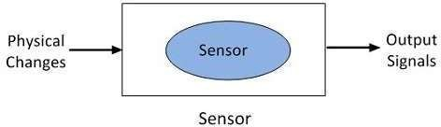
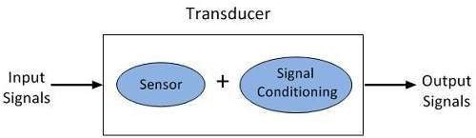
Difference between Sensor and Transducers
Sensors – the term sensor is used for an element which generates a signal which is proportional to the quantity being measured.
Transducer – these are elements
when change change.
subjected to
experience a
physical
related

Slide 27
Difference between Sensor and Transducers
Basis For Comparison | Sensor | Transducer
Definition | Senses the physical changes occurs in the surrounding and converting it into a readable quantity. | The transducer is a device which, when actuates transforms the energy from one form to another.
Components | Sensor itself | Sensor and signal conditioning
Function | Detects the changes and induces the corresponding electrical signals. | Conversion of one form of energy into another.
Examples | Proximity sensor, Magnetic sensor, Accelerometer sensor, Light sensor, Barometer, Gyroscope etc. | Thermistor, Potentiometer, Thermocouple, etc.

Slide 28
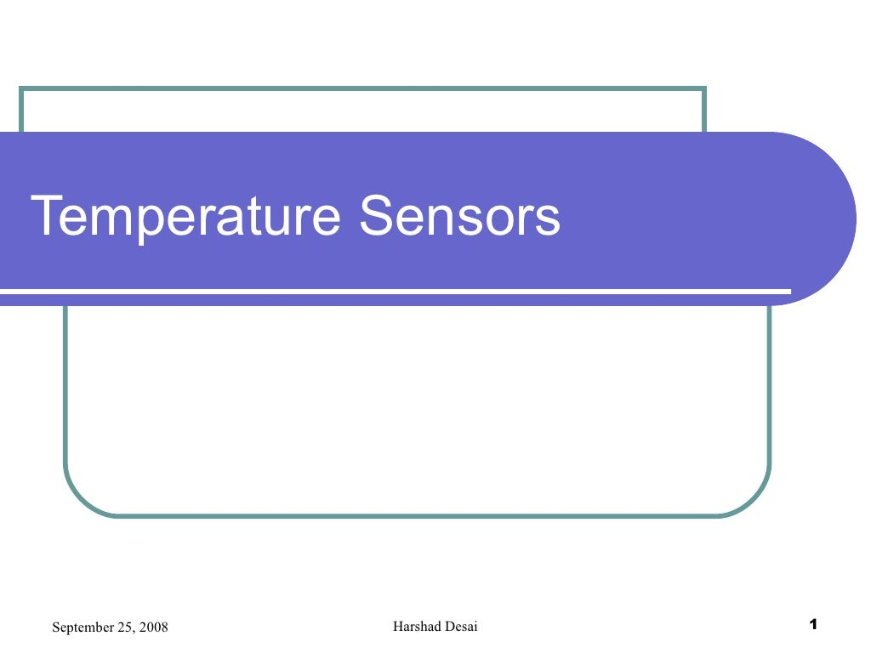

Slide 29
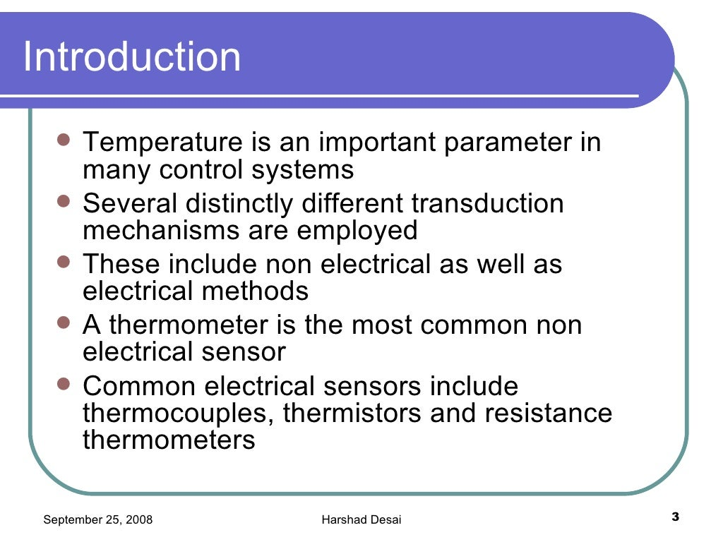

Slide 30
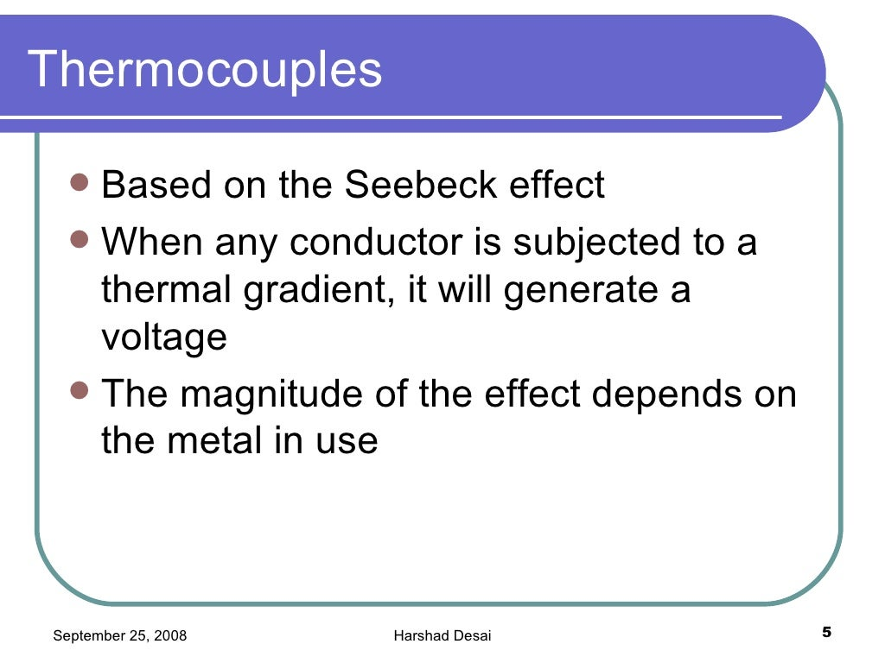

Slide 31
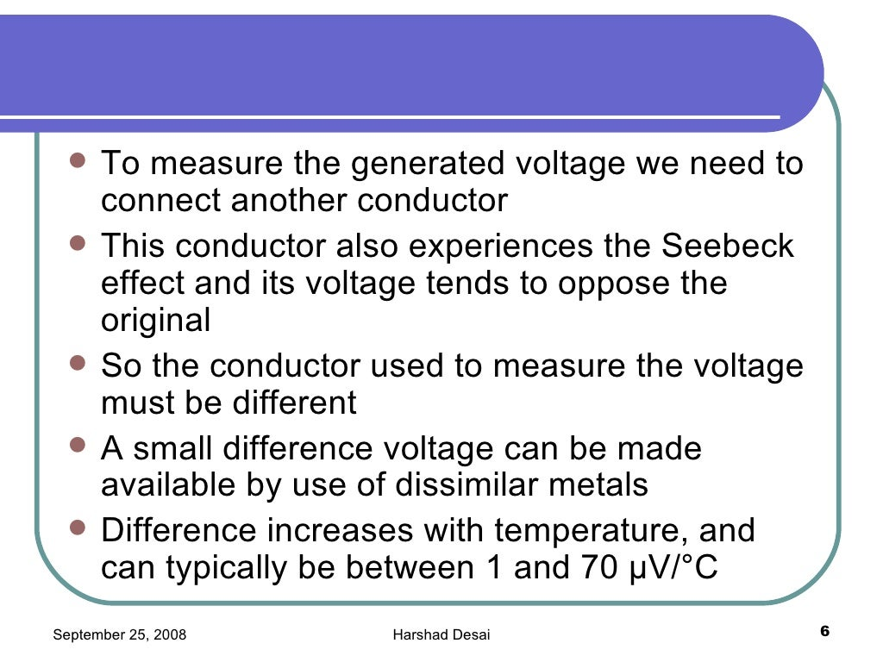

Slide 32
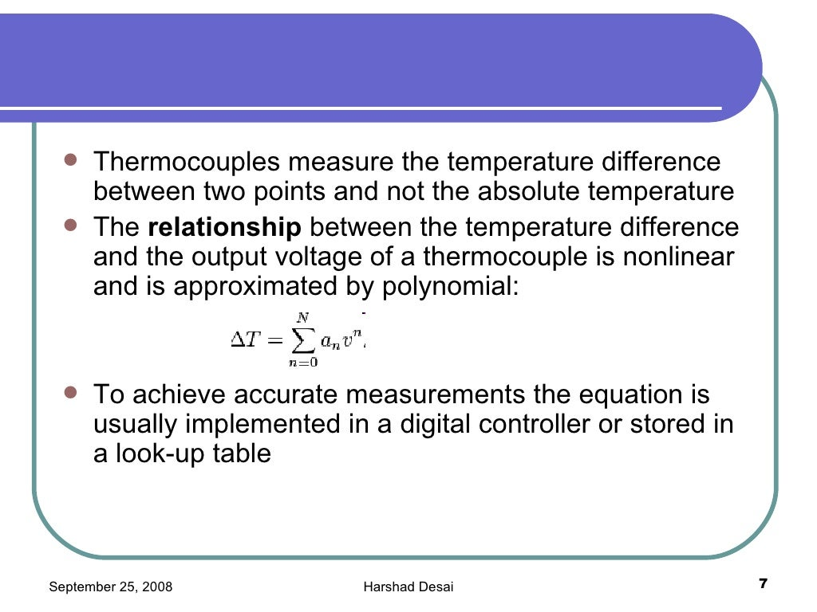

Slide 33
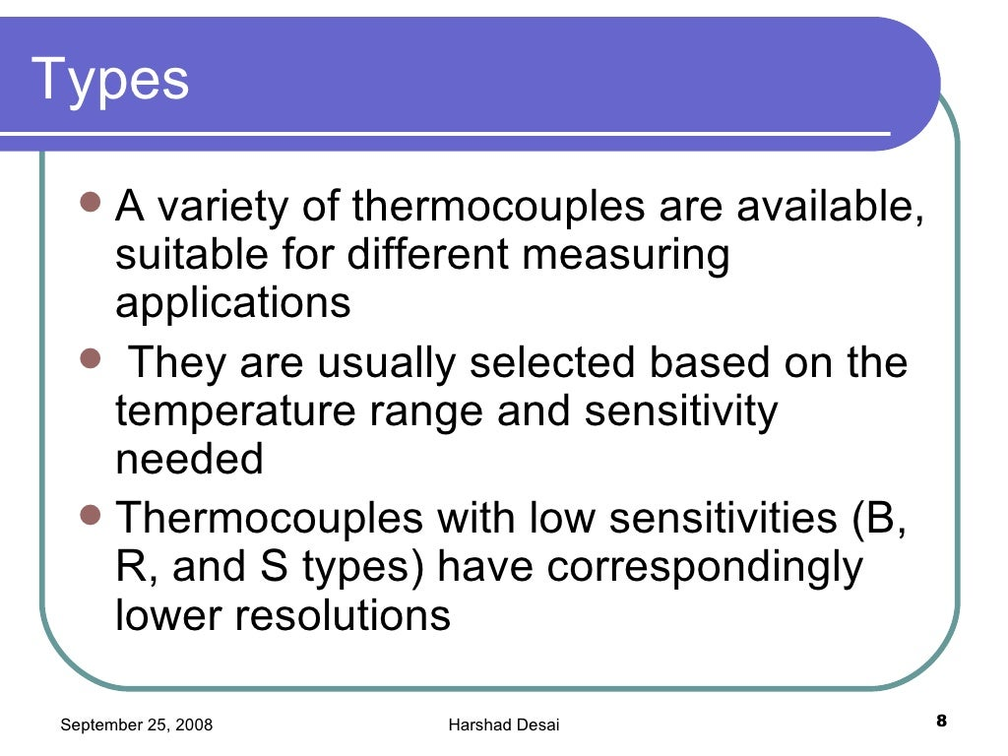

Slide 34
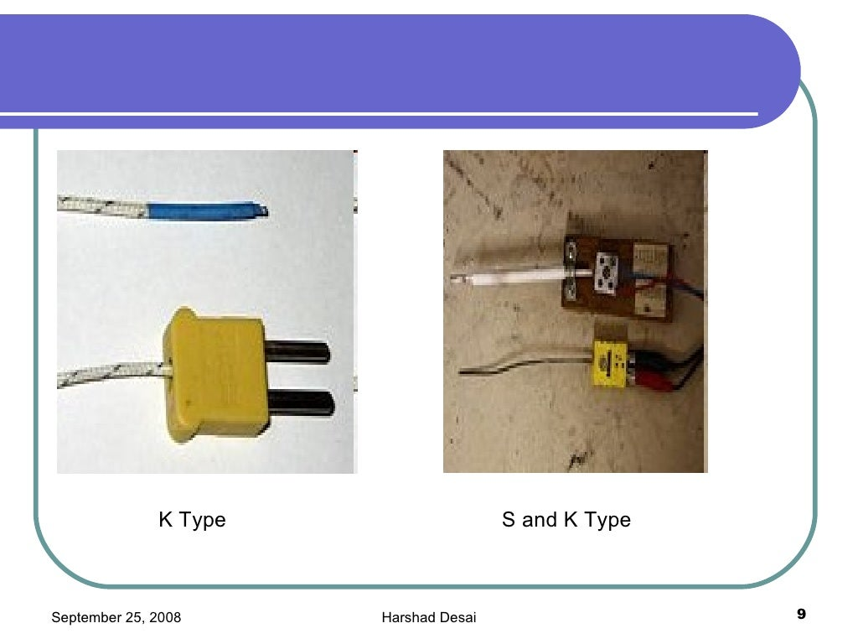

Slide 35
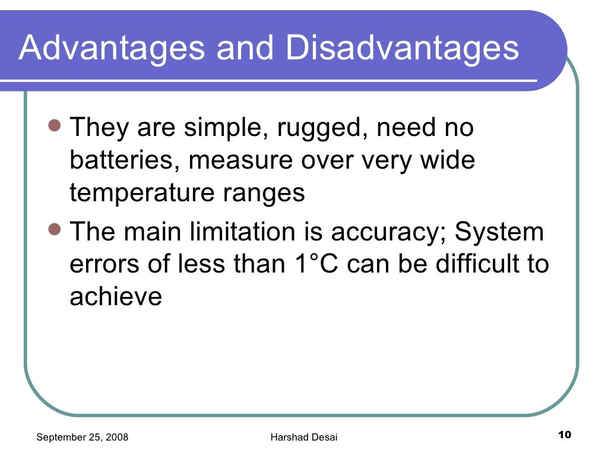

Slide 36
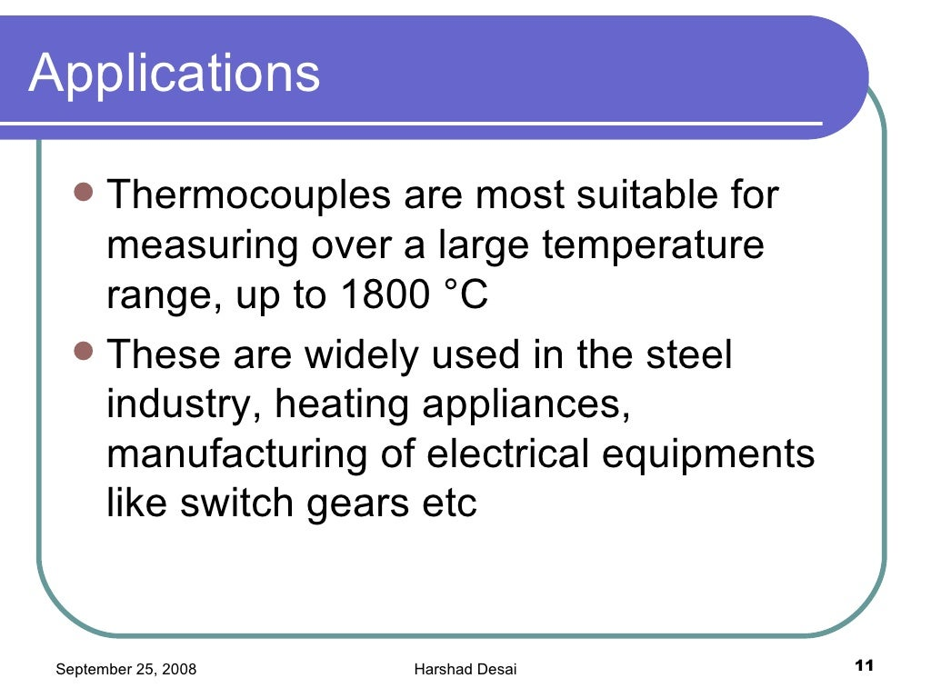

Slide 37
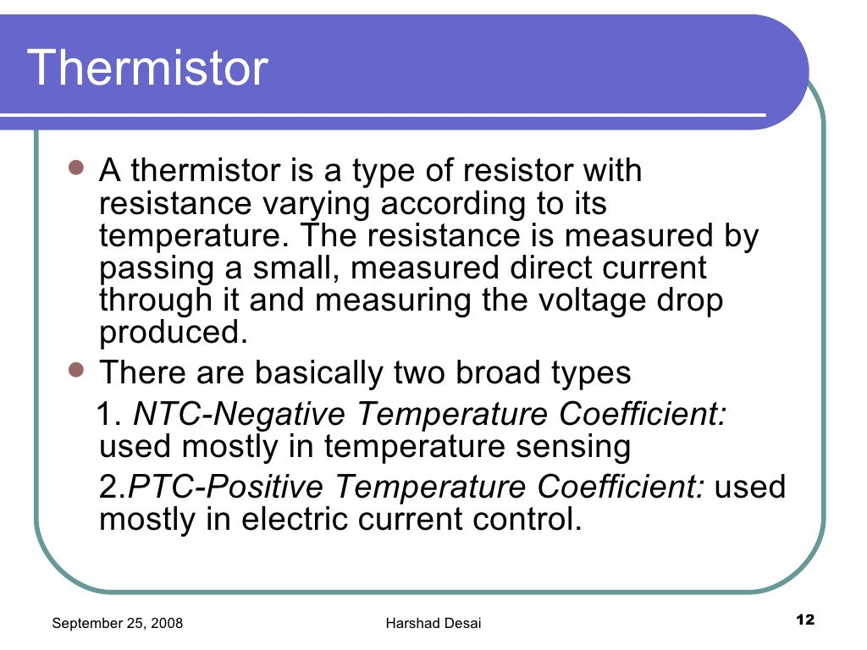

Slide 38
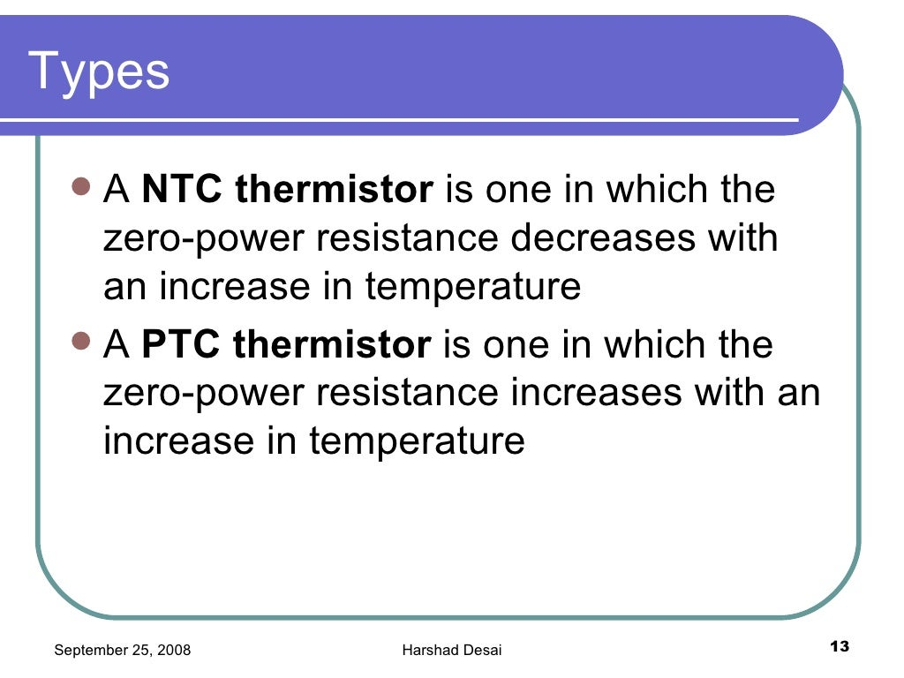

Slide 39
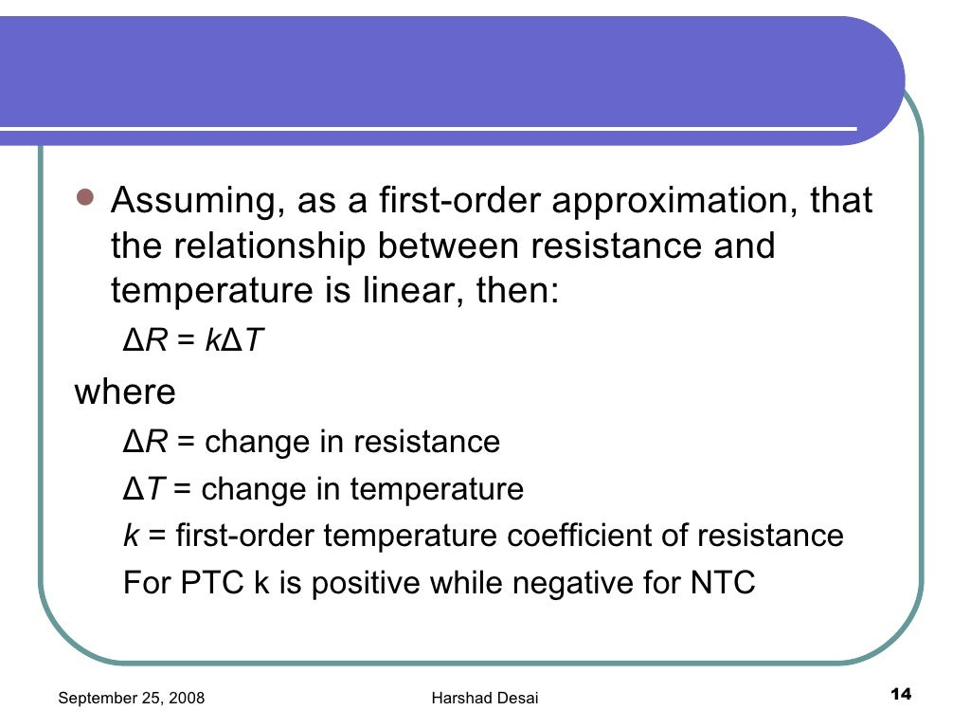

Slide 40
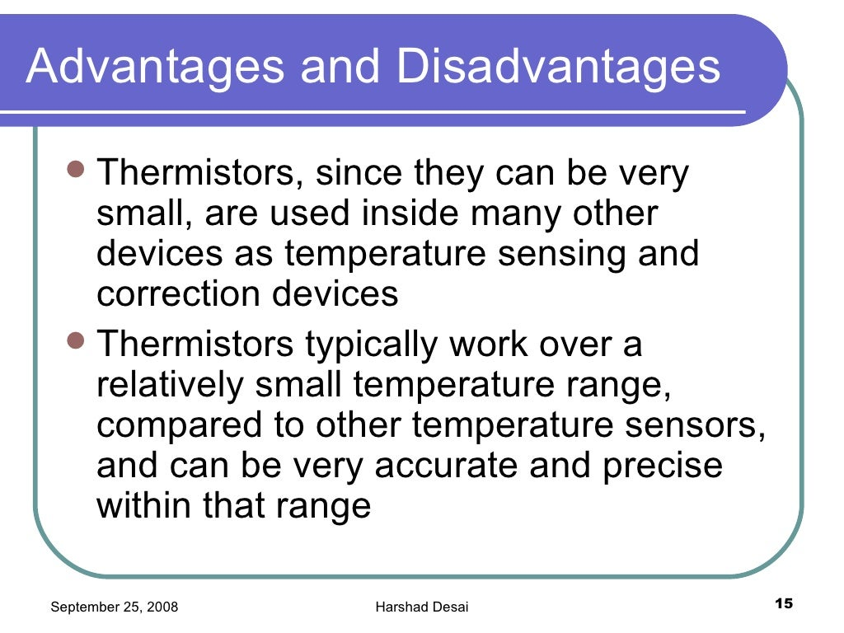

Slide 41
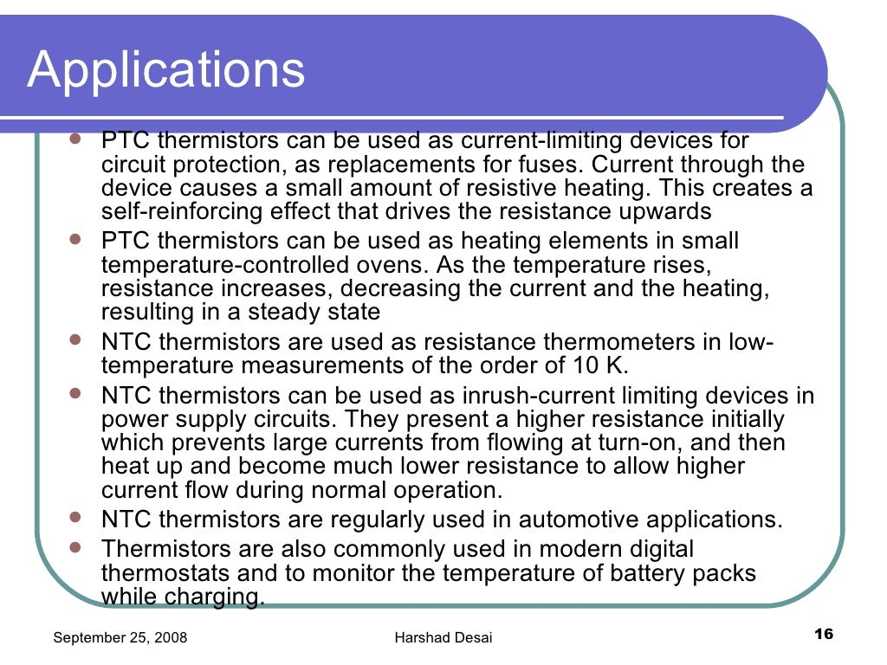

Slide 42
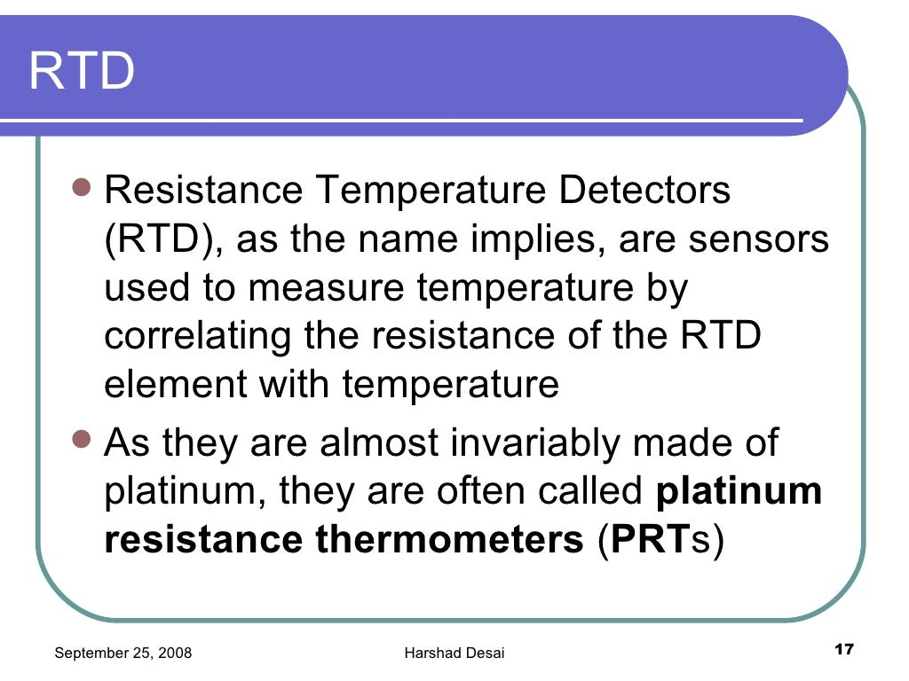

Slide 43
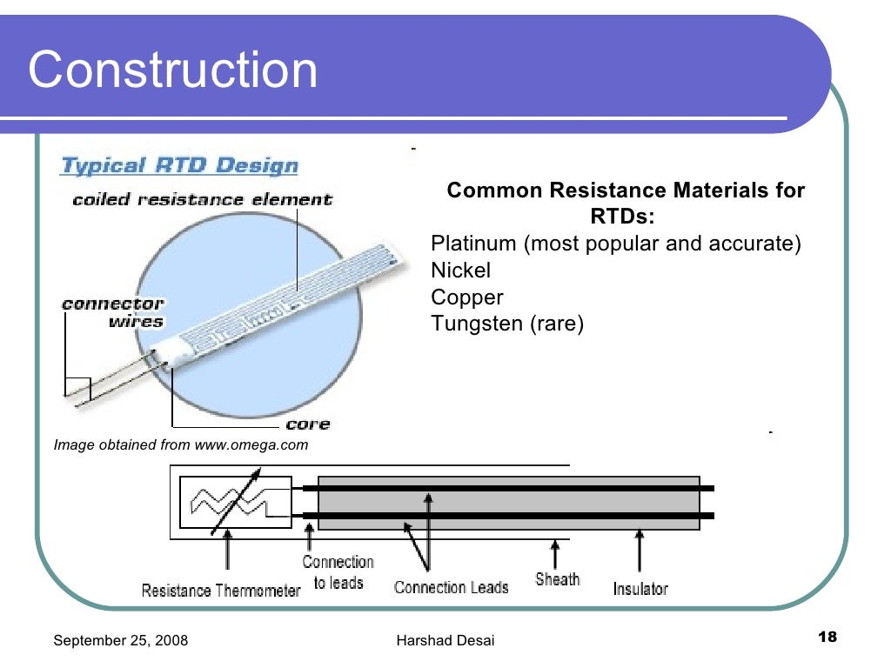

Slide 44
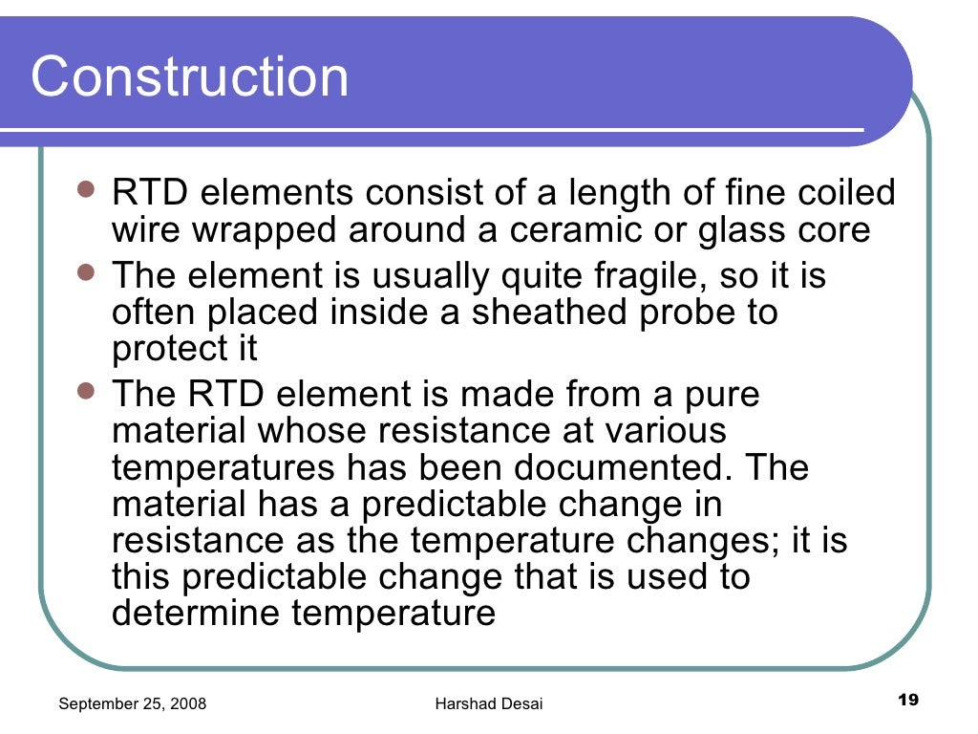

Slide 45
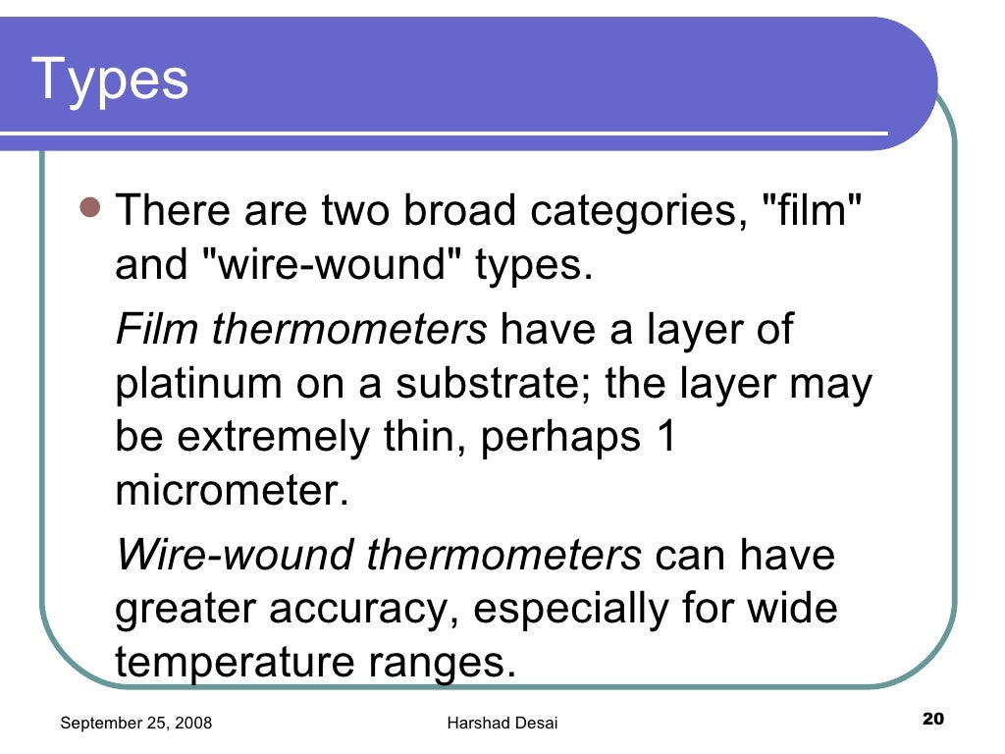

Slide 46
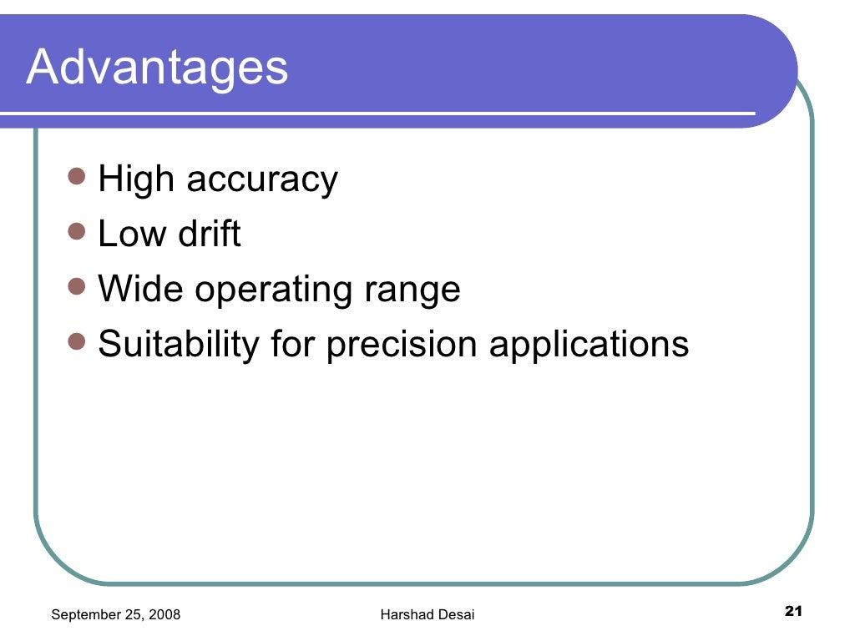

Slide 47
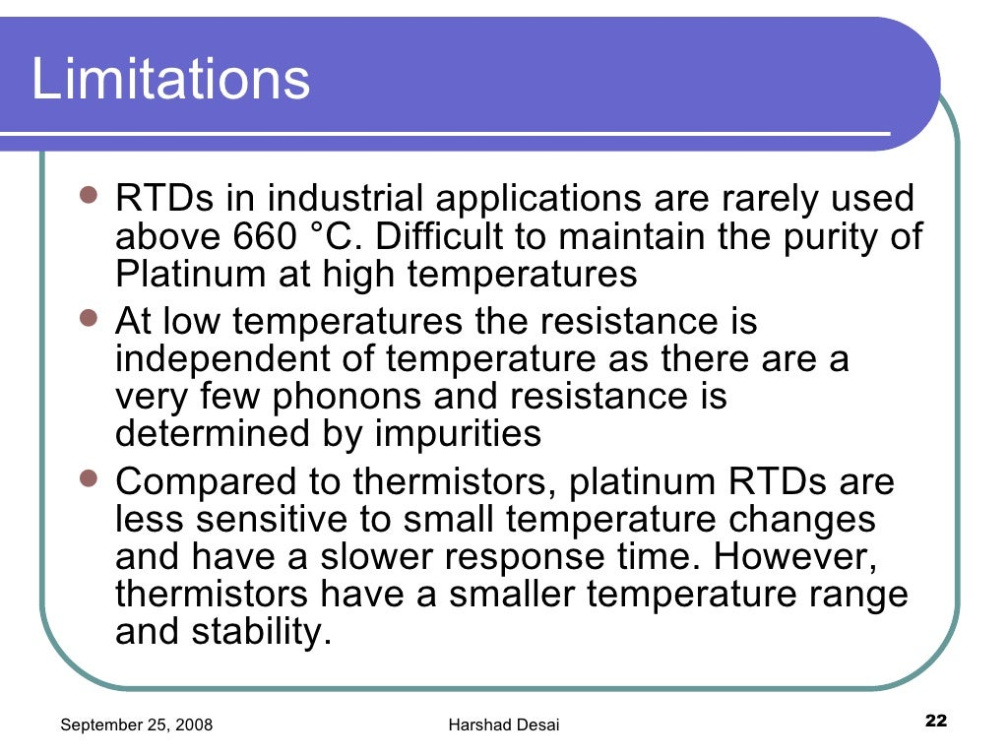

Slide 48
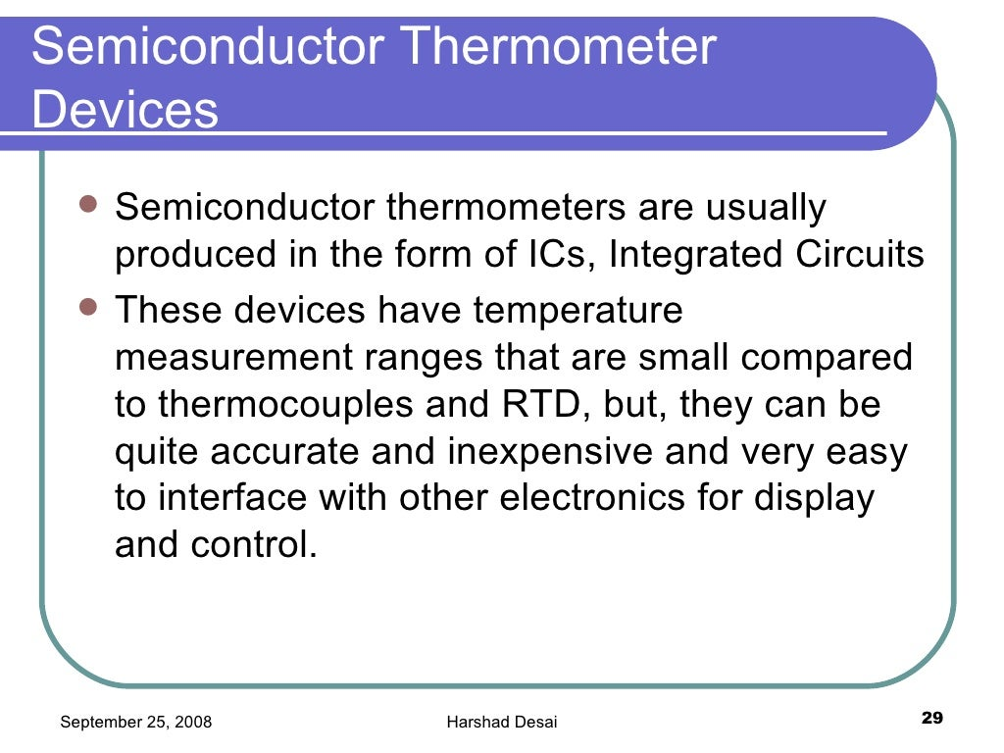

Slide 49
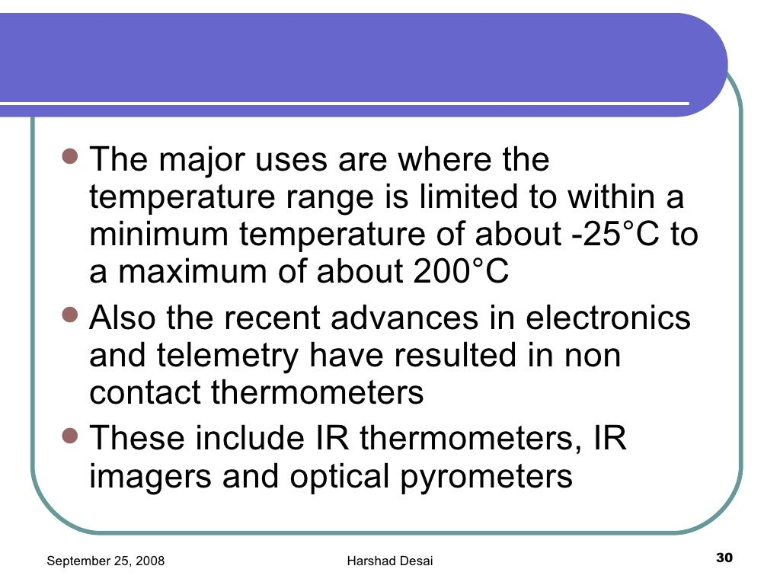

Slide 50
Sensors for Electromechanical Applications
Motion Transducers
By motion, we particularly mean one or more of the following four kinematic variables:
Displacement (including position, distance, proximity, size, and gauge)
Velocity (rate of change of displacement)
Acceleration (rate of change of velocity)
Jerk (rate of change of acceleration)

Slide 51
Motion Transducer Selection
In selecting a motion transducer, we need to consider several factors.
Several preliminary considerations
are as follows:
Kinetic nature of the measurand (position, proximity, displacement,
speed, acceleration, etc.)
Rectilinear (commonly termed linear) or rotatory (commonly termed
rotary) motion
Contact or noncontact type
Measurement range
Required accuracy
Required frequency range of operation (time constant, bandwidth)
Size
Cost
Operating environment (e.g., magnetic fields, temperature, pressure, humidity, vibration, shock)
Life expectancy

Slide 52
Force Sensors for Motion Measurement
An inertia element (to convert acceleration into force, in proportion)
A damping element (to convert velocity into force, in proportion)
A spring element (to convert displacement into force, in proportion)

Slide 53
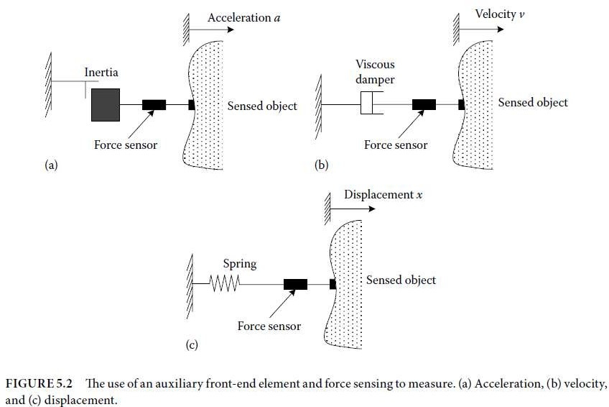

Slide 54
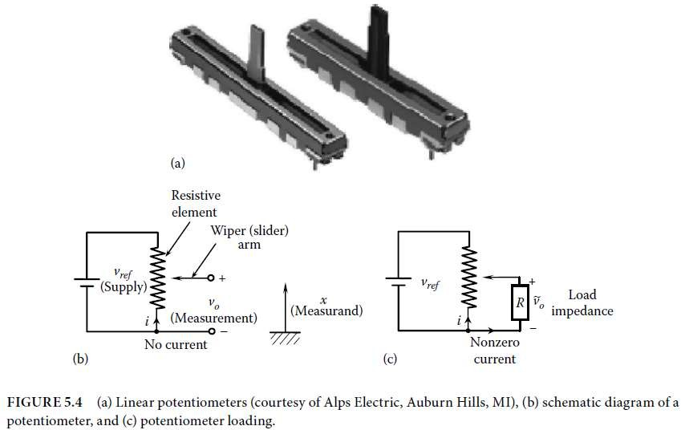
Potentiometer

Slide 55
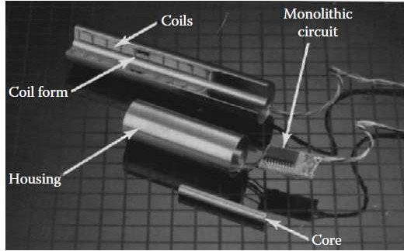
Linear-Variable Differential Transformer/Transducer

Slide 56
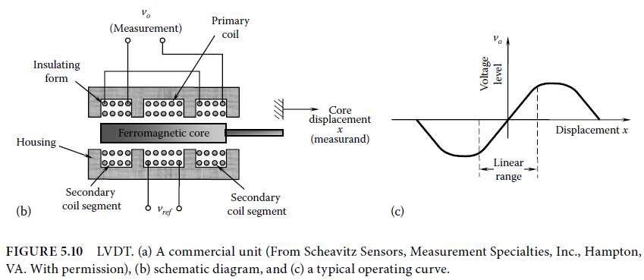
Linear-Variable Differential Transformer/Transducer

Slide 57
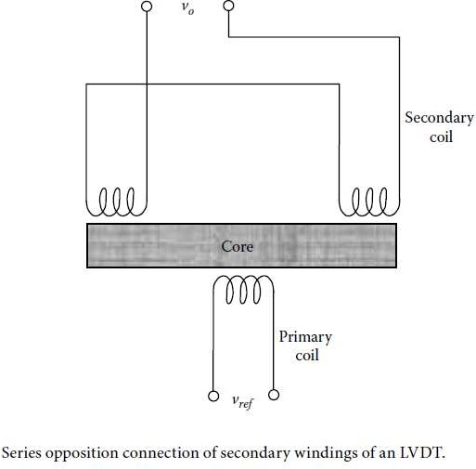

Slide 58
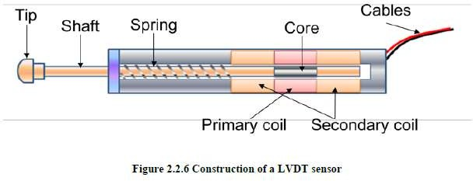

Slide 59
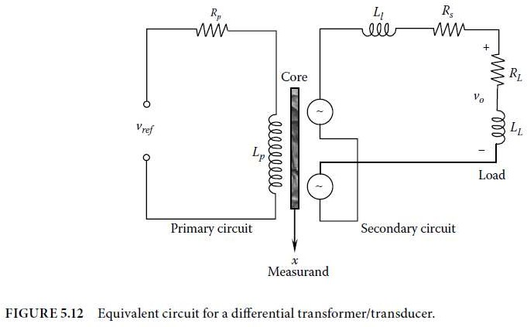

Now suppose that the core, length L, is moved through a
distance x from the null position

Slide 60
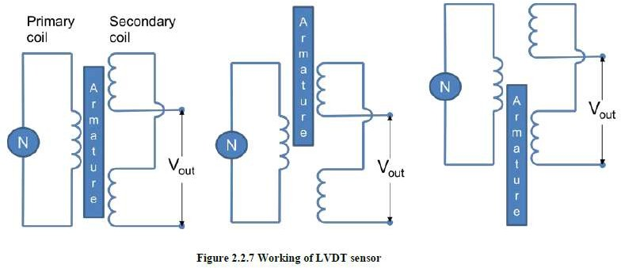

Slide 61
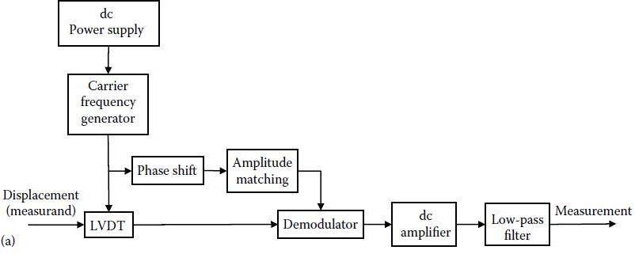
Signal Conditioning for LVDT

Slide 62
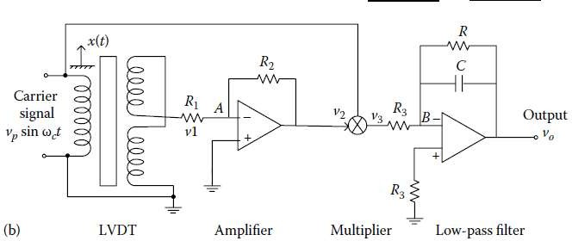
Signal Conditioning for LVDT

Slide 63
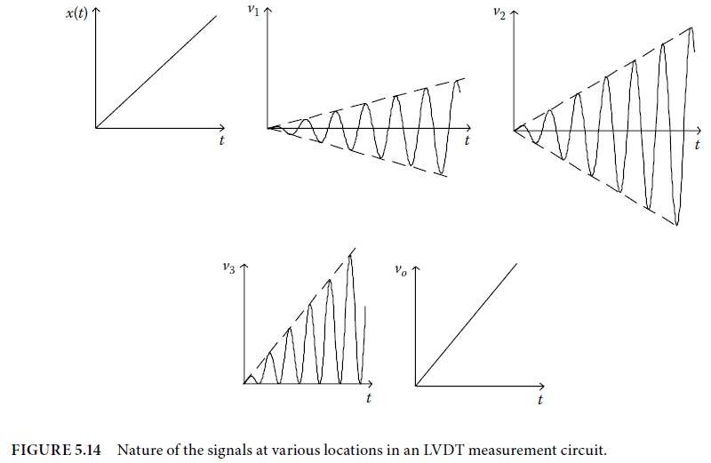
Signal Conditioning for LVDT

Slide 64
Advantages of the LVDT include the following:
It is essentially a noncontacting device with no frictional resistance. Near-
ideal electromechanical
energy conversion and lightweight core will result in very small resistive forces.
Hysteresis (both
magnetic hysteresis and mechanical backlash) is negligible.
It has low output impedance, typically in the order of 100 Ω. (Signal
amplification is usually not
needed beyond what is provided by the conditioning circuit.)
It provides directional measurements (positive/negative).
It is available in miniature sizes as well (e.g., length of 1 or 2 mm,
displacement measurements of
a fraction of a millimeter, and maximum travel or stroke of 1 mm)
It has a simple and robust construction (inexpensive and durable)
It has fine resolutions (theoretically, infinitesimal resolution; practically, much better than a coil
potentiometer).

Slide 65
Mutual-Induction Proximity Sensor
Proximity sensors are used in a wide variety of applications pertaining to noncontacting displacement sensing and dimensional gaging. Some typical applications are
Measurement and control of the gap between a robotic welding torch head and
the work surface
Gaging the thickness of metal plates in manufacturing operations (e.g., rolling
and forming)
Detecting surface irregularities in machined parts
Measurement of angular speed, by counting the number of rotations per unit time
Measurement of vibration in rotating machinery and structures (for machine health monitoring
and control, etc.)
Detection of liquid level (e.g., in the filling, bottling, and chemical process
industries)
Monitoring of bearing assembly processes

Slide 66
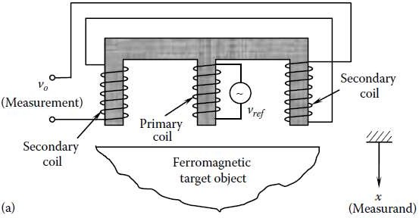
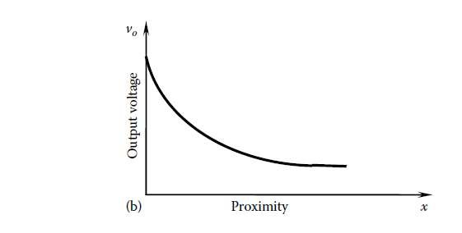
Mutual-Induction Proximity Sensor

Slide 67

capacitive sensors
(a) Capacitive displacement sensor

Slide 68

capacitive sensors
(b) capacitive rotation
sensor

Slide 69



Slide 70

capacitive sensors
(c) capacitive liquid level sensor.

Slide 71

liquid level (y) is based on the
variation of the dielectric constant (k) of the capacitor, while A and x are kept constant in Equation below Since the voltage in the air segment (a) and the liquid segment (l) of the capacitor is the same while the charges are additive, the capacitances are additive:

Slide 72

Hence, we can express the liquid level as
where
x is the plate gap
h is the plate height
b is the plate width
ka is the permittivity of air
kl is the permittivity of the liquid

Slide 73
Applications of Capacitive Sensors
Motion sensing (e.g., wafer positioning in semiconductor (SC) industry, disc drive control,machine-tool control)
Gauging and metrology (e.g., thickness of plates, gauging manufactured parts for
quality control)
Object detection (e.g., counting parts in production lines, detecting cap placement in bottling plants, touch button switches of elevators, etc.)
Liquid level sensing in (e.g., in process plants)
Material testing (e.g., surface properties of objects, detecting water in fuels)
Environmental sensing (e.g., moisture, soil)

Slide 74
Piezoelectric Sensors
Piezoelectric effect: The piezoelectric effect is caused by the charge polarization in an anisotropic material (having nonsymmetric molecular structure), as a result of an applied strain. Specifically, a charge (or electric field) is released when the material is strained. This is a reversible effect.
In particular, when an electric field is applied to the material, it changes the ionic polarization, and the material sheds the strain (i.e., the original strain is removed and the material regains its original shape).
Natural piezoelectric materials are by and large crystalline, whereas synthetic piezoelectric materials tend to be ceramics.

